Slide 1


ConcreteNet
A CNN for Deformity Detection and Classification in GPR Images
Anish Goyal
Georgia Southern University
Southern Regional Honors Conference 2025

Slide 2
Overview
The periodic reassessment of concrete is really important for the safety compliance of buildings, bridges, and highways
Modern technology and signal processing allows us to view deformities in concrete without harming the concrete
We can use AI to detect and classify these deformities when scientists and engineers are on the ground

Slide 3
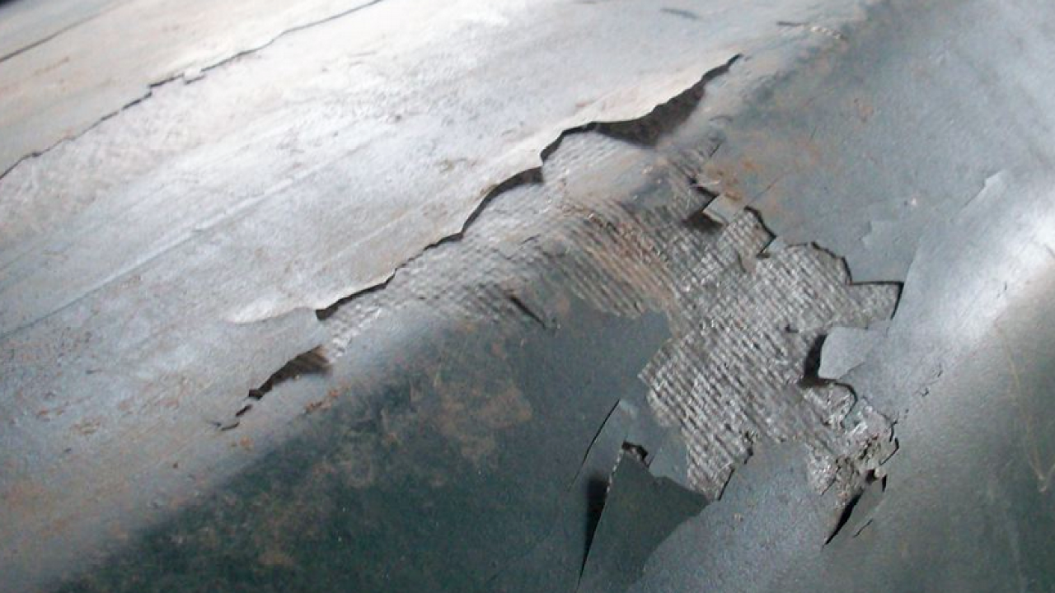
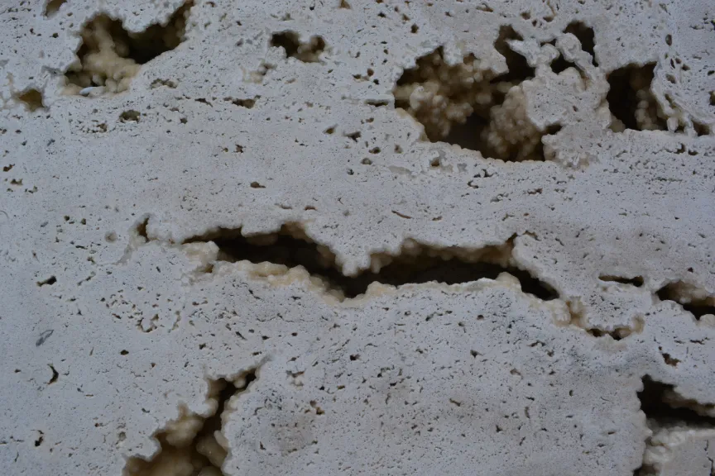
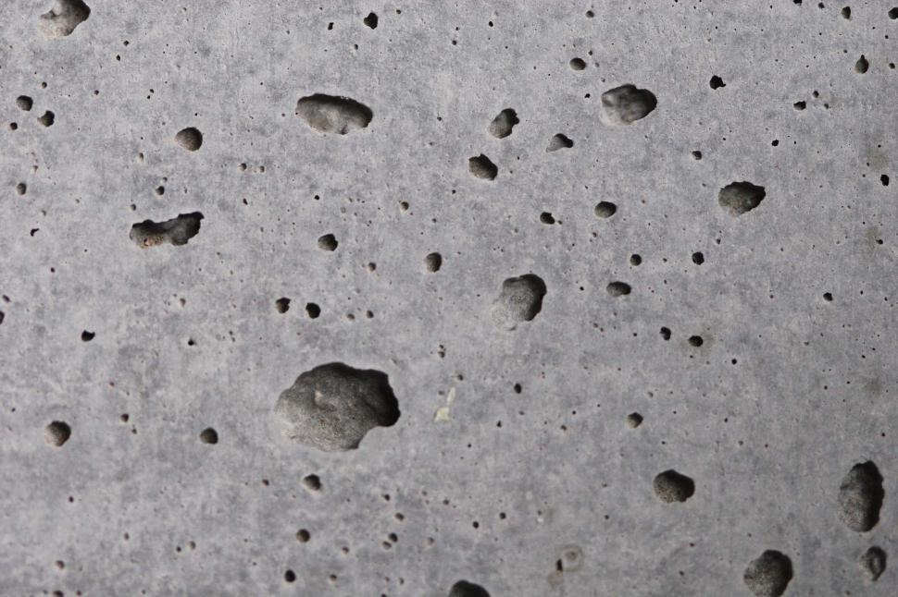
Types of concrete deformation
Notes:
Delamination is a huge issue that occurs in concrete where the layers of it concrete start to separate at the surface, or extremely close to the surface, of the material. Next, we have voids. A void is any hole that exists in the concrete. And they can go completely unnoticed if they're underneath the surface of the concrete, which affects the structural integrity. When engineers pour concrete, they try to ensure the hot asphalt is as flattened as possible. Because if there are any air bubbles or pockets in the asphalt they lay down, all of the asphalt will harden around those air bubbles. Another type of deformity is honeycombing. Honeycombs are a bunch of little small voids in close proximity to each other. This is usually an indication that the asphalt solution was not properly mixed or evenly distributed prior to pouring .

Slide 4
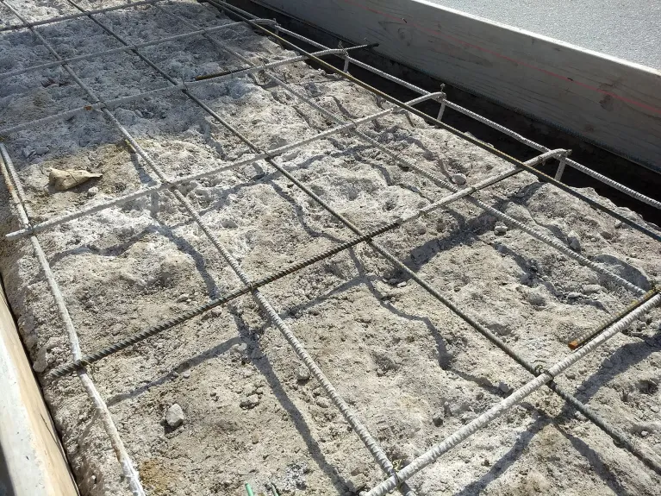
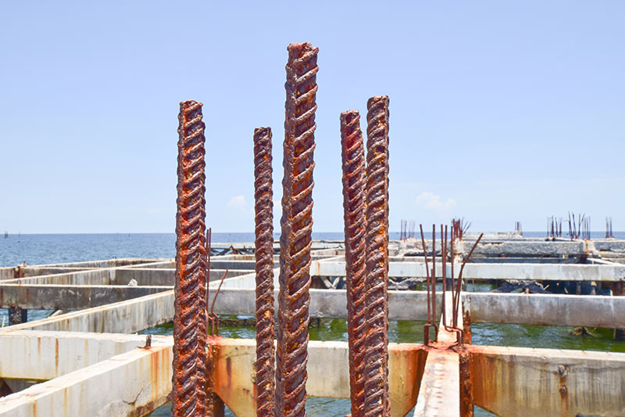
Structural deformation in rebars
Ensure consistent distance
No bending/corrosion!
Notes:
Reinforced concrete contains rebars. Rebars are these steel beams that increase the tensile strength of the concrete. They're laid out in a grid arrangement before the concrete is poured, as you can see in this image. One important detail to consider is that rebars have to be spaced out evenly, or the load distribution changes, which will cause weak points in the structure. Although rebars may be laid out properly at first, they can become spaced out from one another over time. Additionally, we want to avoid rebar bending and corrosion at all costs! Bending is bad because it can lead to structural failure. And if the rebar starts to corrode, then the concrete will begin to oxidize and crack.

Slide 5
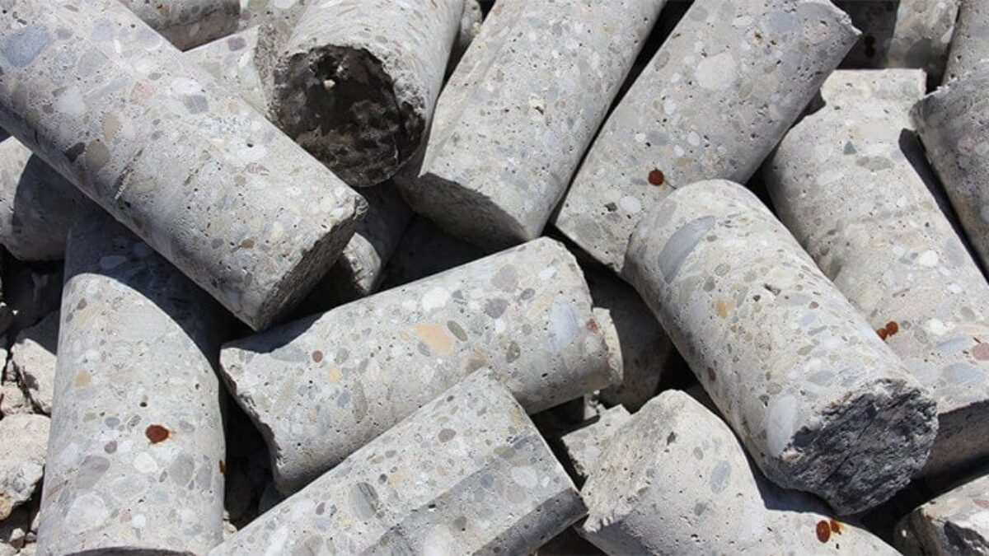
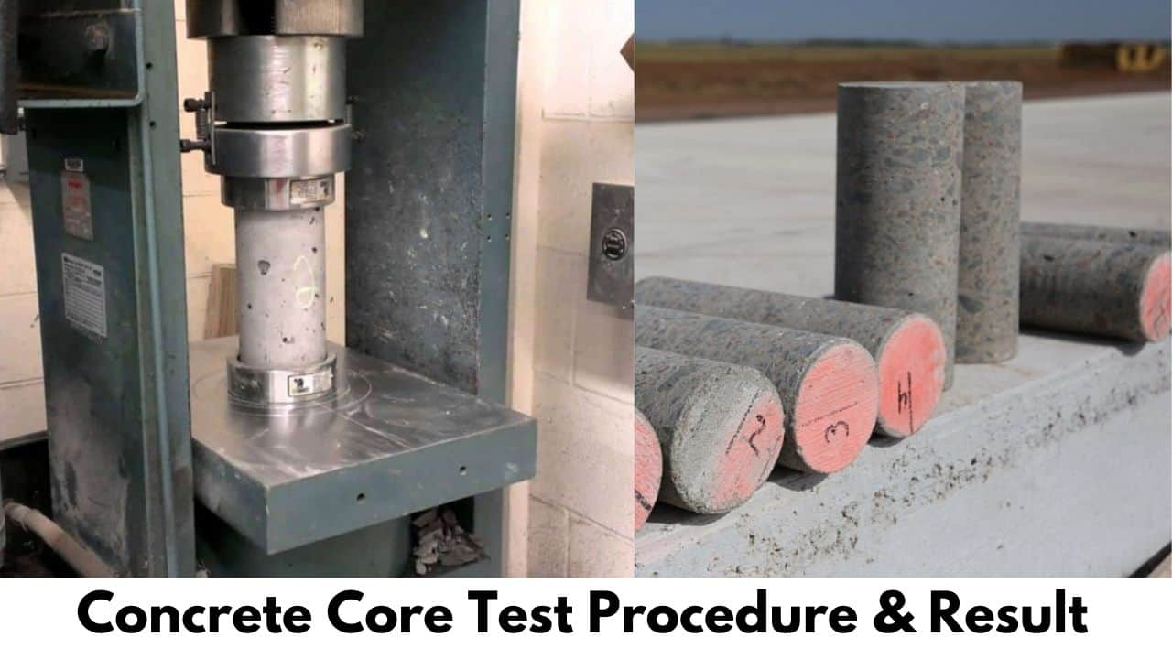
How we used to assess concrete
Notes:
k

Slide 6
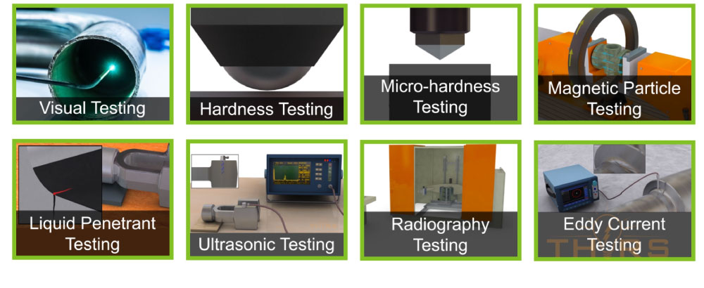
Nondestructive testing
Notes:
Now have nondestructive testing (NDT), where we use infrared thermography, ultrasonic testing, ground-penetrating radar (GPR), and radiography to be able to "see" through concrete structures without actually harming the concrete itself. GPR is the most commonly used method because of its reliability and effectiveness, but other NDT methods are good too for some specific use cases.

Slide 7
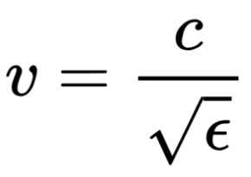
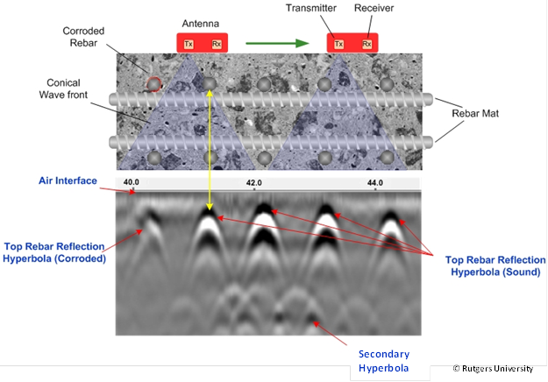
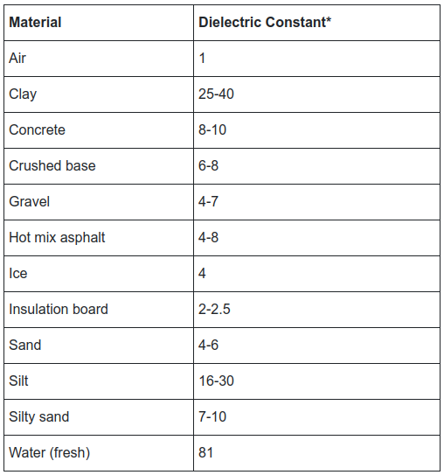
Ground-penetrating radar
Use EM waves to see through concrete via dielectrics
Notes:
GPR works by using electromagnetic waves to see through concrete and other materials. The key to this is something called dielectric properties, which describe how a material interacts with an electric field. Different materials allow electromagnetic waves to travel at different speeds, as described by the following equation. GPR machines use this principle by sending out pulses of electromagnetic waves through a transmit (TX) antenna and capturing the reflections with a receive (RX) antenna. When these waves hit something with a different permittivity—like a rebar, a void, or a defect—they bounce back at different times. The system records these reflections, and by measuring the time between the transmitted and received signals, we can calculate depth and identify objects or anomalies beneath the surface.
GPR data can be analyzed in three different formats:
A-scan (Amplitude Scan): This is the simplest format. It’s a one-dimensional plot showing the amplitude of reflected signals over time. Essentially, it tells us how strong the reflections are at different depths)
B-scan (Brightness Scan): This is a two-dimensional radargram made up of multiple A-scans. It provides a cross-sectional view, showing reflections as hyperbolas where objects are detected. This is the most common way GPR data is analyzed.
C-scan (Contour Scan): This is a three-dimensional representation created by stitching together multiple B-scans. It provides a top-down view and helps engineers understand the spatial distribution of features
Since GPR data is captured in the time domain, many researchers find it particularly useful to take the fourier transform to be able to see the data in the frequency domain. If there are any components of the signal with a higher frequency than the rest, this is a potential indicator of a defect in the concrete.

Slide 8
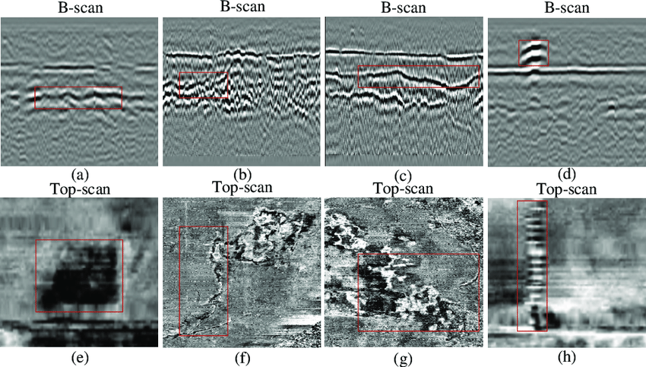
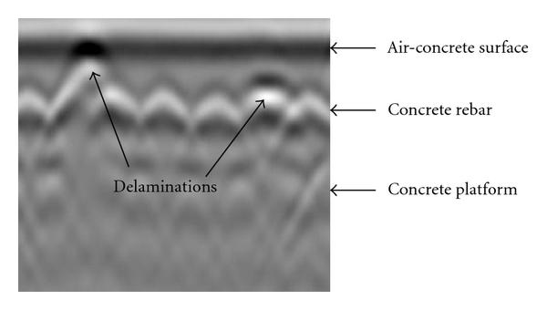
Interpreting GPR radargrams is not trivial
Notes:
Interpreting data of a GPR scan is really difficult. You have to be a trained, licensed professional to be able to notice some of these defects, as most of the detections of deformities in concrete are not immediately obvious. This is because GPR scans are really noisy. Depending on the bandwidth and image resolution of the antennae, the features can show up very faint, and it is hard to see in many cases. Void, crack, subsidence (caving in), and a pipe
The solution? Leverage convolutional neural networks (CNNs) to be able to capture specific edges and features in each radargram image to assist scientists and engineers with deformity detection while on the ground.

Slide 9
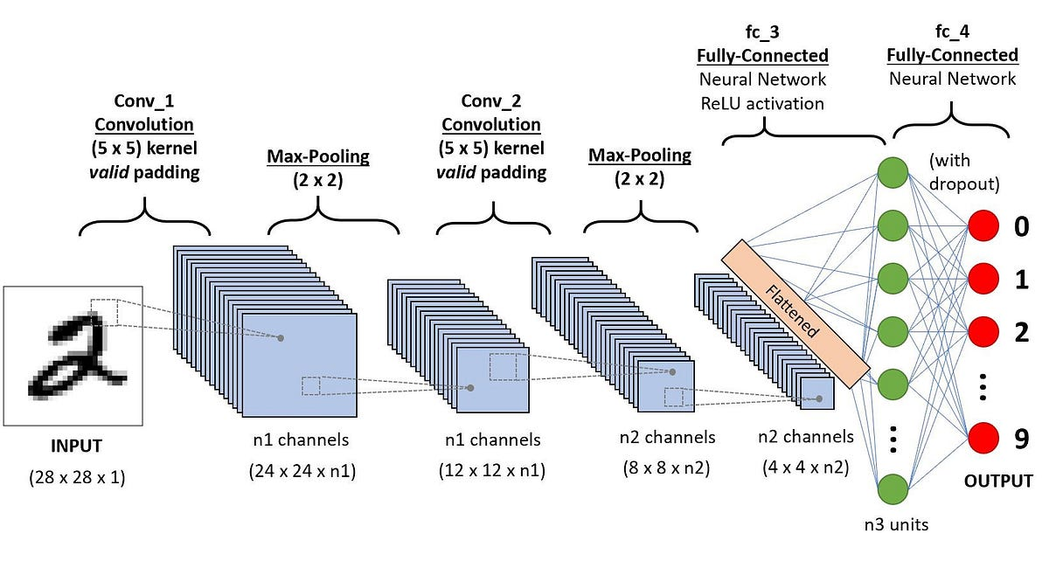
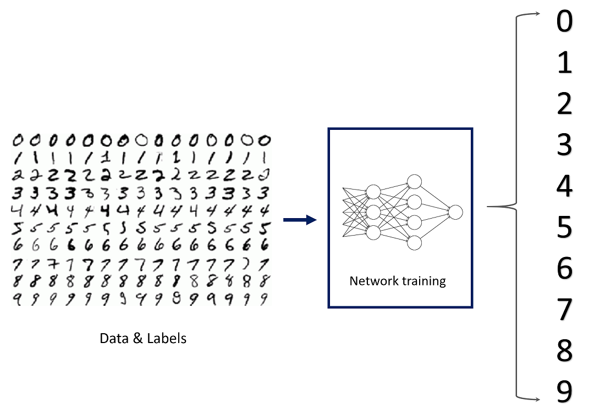
“Conva what now?”
“Really complicated math machines”
Notes:
At their core, convolutional neural networks (CNNs) are just really complicated math machines. They take in an image, process it through a series of mathematical operations, and learn to recognize patterns—like edges, shapes, or even complex features like cracks in concrete. To understand how CNNs work, let’s start with a basic neural network, known as a multilayer perceptron (MLP). This is made up of layers of "neurons," each performing mathematical operations on the input data. The goal is to adjust the network’s internal settings (weights) so that it makes correct predictions.
Training a neural network involves minimizing error, or how far off its predictions are from the correct answers. This is done using gradient descent, an optimization process that tweaks the network’s weights little by little until it improves.
The network learns through a process called backpropagation, which works like this:
The network makes a prediction.
The error is measured (loss function).
The network calculates how much each neuron contributed to the error.
The weights are adjusted to improve accuracy.
Repeat thousands (or millions) of times.
CNNs excel at processing images, including the radargram images from GPR They automatically detect features—like rebars, voids, or honeycombing—without needing a human to manually interpret noisy data.

Slide 10
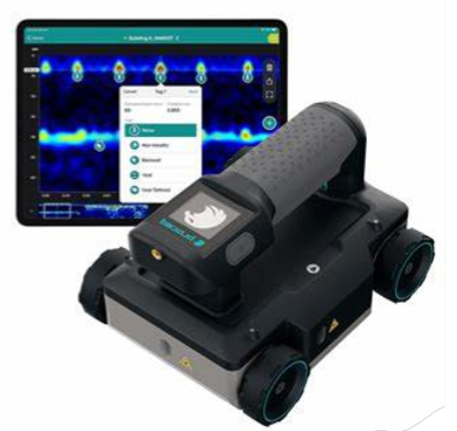
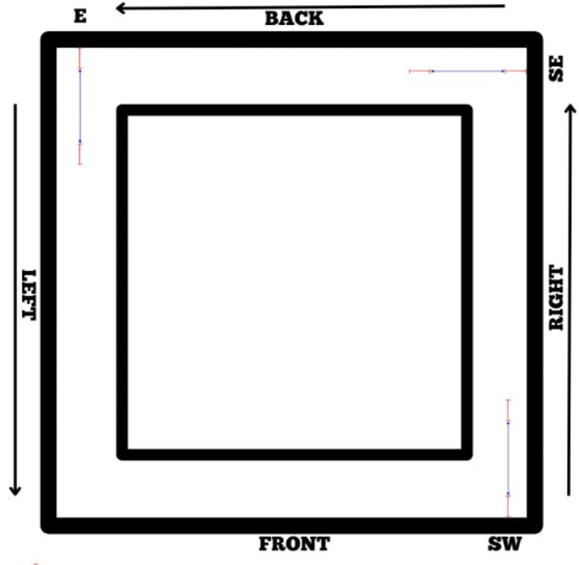
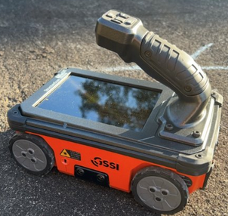
Data collection
Proceq GP8000
GSSI Mini XT
Notes:
We took a bunch of floor scans from the engineering research building at georgia southern. The engineering research building is extremely modern and only four years old, built only four years ago. Using two state-of-the-art GPR machines that are used by civil engineers today, we canvassed 26 feet using both of these machines with an increment of 2 feet per scan. We repeated this four times for one of each of the four hallways that we had.

Slide 11
Training and evaluation process
Split into training and validation datasets to avoid overfitting
Four key metrics
Accuracy: The percentage of correct predictions.
Precision: Of the defects the model detected, how many were actually defects?
Recall: Of all the actual defects, how many did the model correctly detect?
F1 Score: Combines precision and recall; implies both are high
Drew bounding boxes and labeled data
Notes:
Once the floor scans were complete, I put one half into the training dataset and the other half into the validation dataset. To see if your model generalizes well under different parameters and conditions. Because of this, it's really important to test a variety of different variables in your dataset to make it more generalizable. Because at the end of the day, neural networks are just really complicated math machines that can only pick up patterns in different variables at a high level. So, if you vary those parameters quite a bit in your dataset, you'll get a good neural network that is able to generalize itself to a variety of conditions. And obviously, the more data you have, the better. We had 180 images in total, and I labeled the training dataset by hand, drawing boxes around each rebar.
Can someone tell me why accuracy alone isn’t enough? Yeah, when defects are really rare, it’s not really the best metric. Okay, we’re going to move on now, but before we do, I want to ask the audience a question. There’s a current major problem with our methodology so far. Given what I've just told you about the generalizability of neural networks, can anyone tell me what a potential problem is with the methodology that I've described in our experiment? Why is it a really bad idea to get data from the Engineering Research Building at georgia southern specifically?

Slide 12
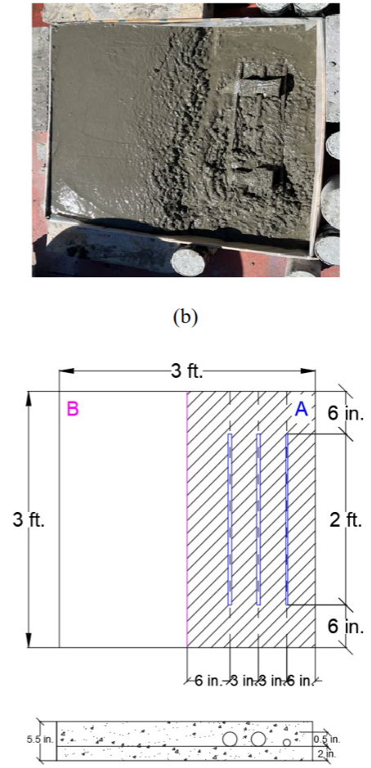
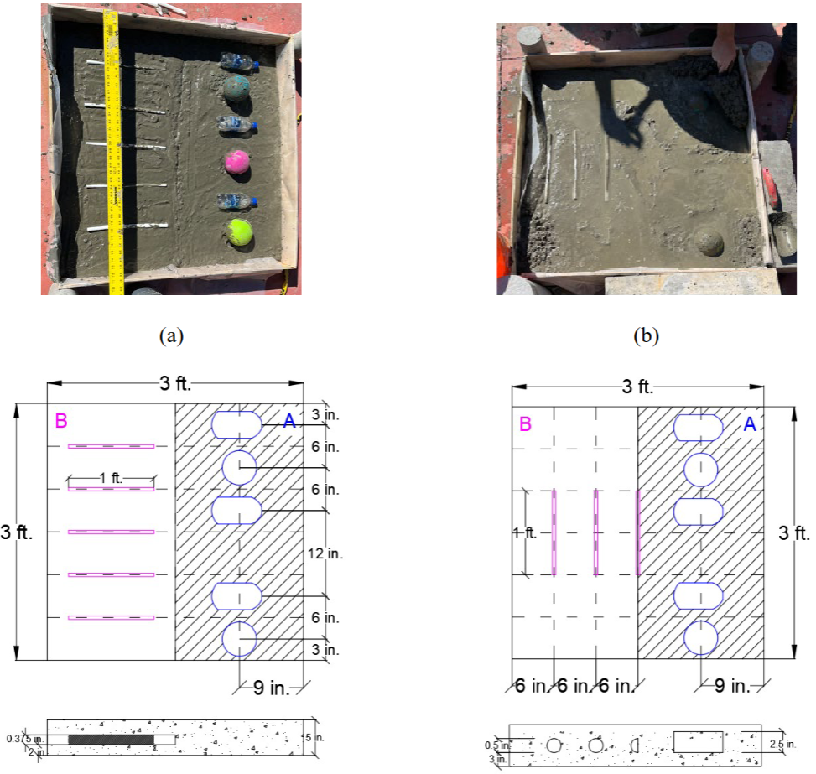
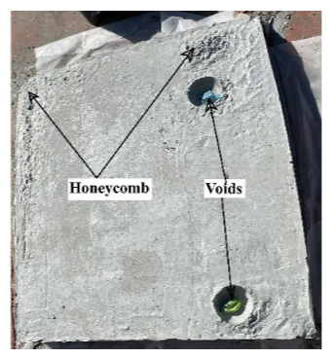
Synthetic embedding
Notes:
Remember what I said about the building being made 5 years ago? Yeah, that's a huge issue! The engineering research building is so new that our GPR scans didn't actually have any deformities in the data set! And since a convolutional neural network can't recognize nor synthesize any data that it hasn't been trained on, how are we going to be able to identify deformities in general? I think we watched a movie yesterday talking about how AI and human intelligence is identical? Well, that's a huge shortcoming of AI right now--at the end of the day, behind the hood, it's just a really complicated math machine, and if we don't introduce defects into the training dataset, it's not going to be able to recognize defects in the validation dataset. Here's how we solved this problem: synthetic Defect Embedding in Controlled Laboratory Conditions. In order to introduce defects into the model, I used a previous grad student's PhD thesis figures to put them into the model. There weren't many images to go off of, and they definitely did not meet similar spec requirements of the data that we collected, but they are similar to what you'll see in general.

Slide 13
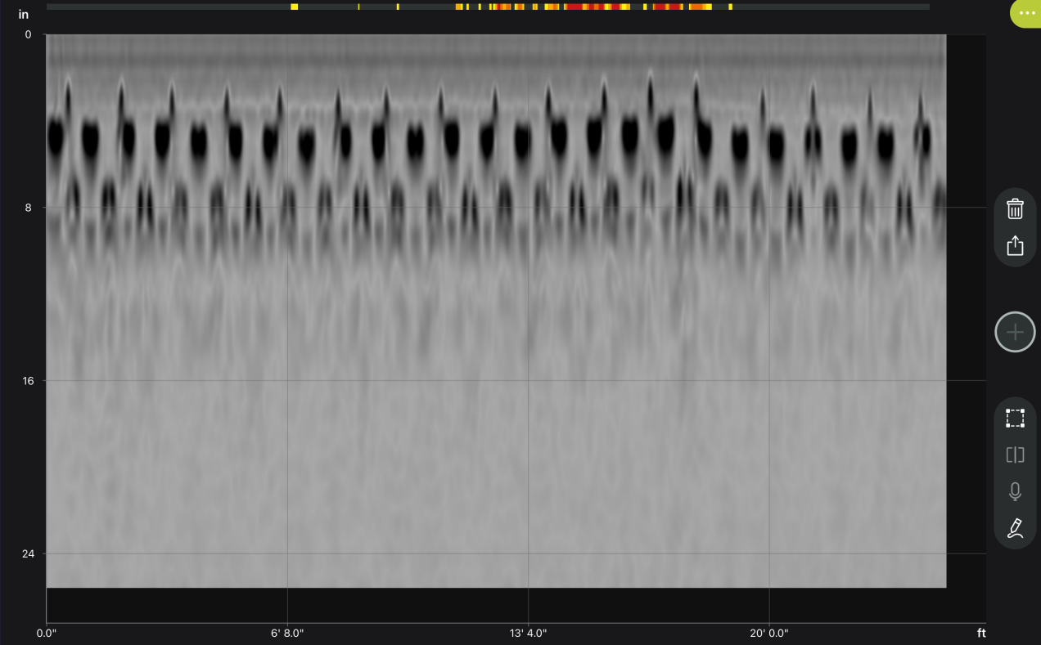
Sample input-output
Notes:
Here is an input/output sequence of the model! We feed it a test image, and it spits out the same image with some bounding boxes around each of the rebars, which appear as hyperbolas. We can calculate the average horizontal distance for each rebar, and if any rebar has a really large outlier, 2 times the standard deviation, we report it. That's all we've done for now, although incorporating all of the other features that I mentioned, such as voids, honeycombing, and delamination shouldn't take very long either. Here are some additional images showing a proof-of-concept of what that would look like for that.

Slide 14
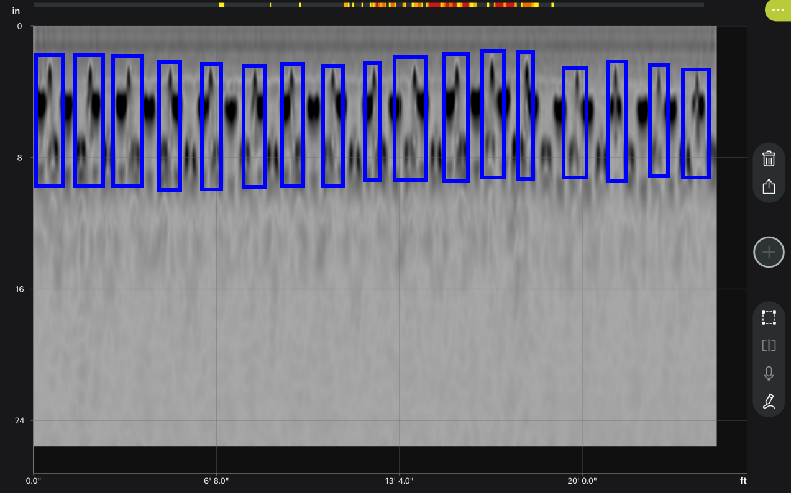
Sample input-output
Notes:
Blue means rebars

Slide 15
Still a WIP
Introduce concrete deformities and retrain the model
Benchmark the model against state-of-the-art image recognition models
Release and open source the final model and data set
Notes:
This project is still a work in progress. I've been working on it for the past semester and a half now. I still need to introduce the simulated deformities into the model, and retrain the neural network. I also still need to benchmark the data set against other state of the art image recognition models that use CNNs as the back end. There are many different public models that can be used for each training such as YOLO, ResNet and DenseNet, and I want to compare my results accordingly, since I created a CNN from scratch. I am releasing the final model and data set as an open-source, public data set for researchers. I actually just received word from the Georgia Department of Transportation that they're going to be using ConcreteNet on the ground for their engineers on the ground conducting bridge assessment. This is really exciting news to me because, not only is it extremely rewarding to see your hard work being used, but also, they'll be collecting live data that I can then feed back into the model and make it better. I'm going to use this information to write two papers--one demonstrating the model's accuracy itself, and another paper looking at the complexity and generalization capabilities of the data that we collected at the Engineering Research Building at Georgia Southern. I actually want to finish this project by the end of the summer. And once I'm done, next year, I plan to use robots that can collect GPR-data autonomously to develop augmented reality glasses that allow engineers to see through the ground for paved roads and highways. Basically: real-time xray vision, which is something straight out of a sci-fi movie, but it's surprisingly close to becoming a reality.

Slide 16
Thank you for your attention
ag29340@georgiasouthern.edu
https://anishgoyal.com
Notes:
So, just to reiterate, ConcreteNet is a tool to help civil engineers, material scientists, and environmental scientists with detecting and classifying deformities in concrete with GPR radar grams. I want to emphasize that ConcreteNet will not replace anybody's job, you still need to be a trained professional to interpret the data, and AI is still very prone to making mistakes, but ConcreteNet will make many experts’ jobs easier, and make the modern infrastructure of our world safer for everyone. I hope you guys learned a lot about the field of nondestructive testing, how neural networks and AI work (albeit at a high level), and ground-penetrating radargrams. If you would like to get in contact with me after the conference is over or see what other research I’m up to, feel free to send me an email or check out my website. Thank you for your attention!

